Slide 1
Frontend
Frontend overview
Introduction
Core components
User management
Products (registered user/guest)
Admin page (CRUD)
Selenium
Frontend conclusion
What did we learn?
Understanding VUE.js
Future development

Slide 2
Why are we making a webshop?
Most online businesses already have their own website.
A webshop requires much less maintenance cost
With a webshop a business can reach a much higher audience
Making a website for a business can be considered a standerd requirement
Conclusion:
Today every business should consider having an online platform,
because it make the difference,
nowdays this fack is widely recognised and more and more
sites are being created to offer a place for online transactions.

Slide 3
Our shop
The NASAPC offers a highly scalable platform for an actual
webshop capable of fulfilling every function a modern webshop should
have and more, on top of providing a great consumer experience.
This is how:
We provide a stabile and fast background for our shop
Website is visually appealing
With a dedictaded mobile application shopping never were easier

Slide 4
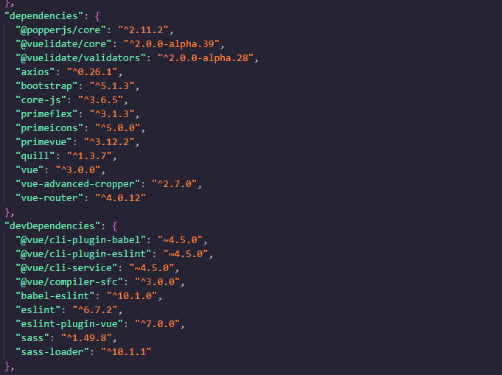
Core components

Slide 5
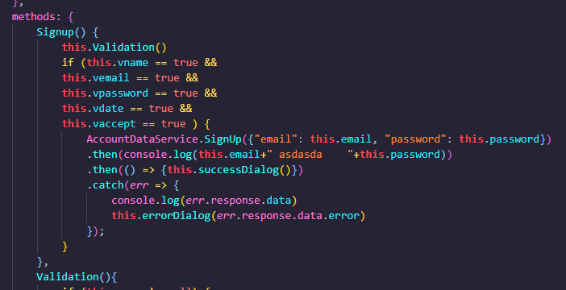
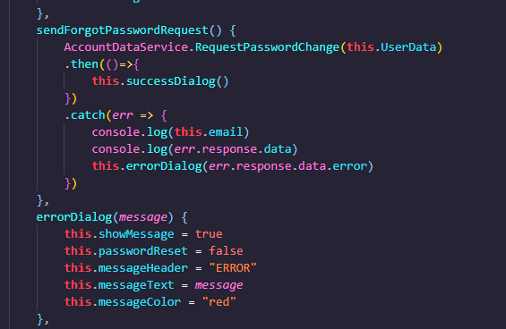
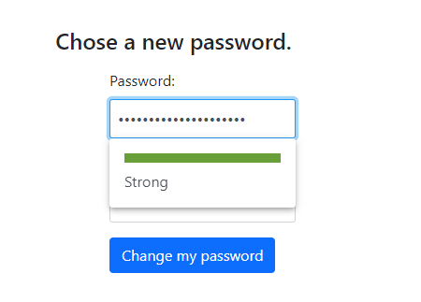
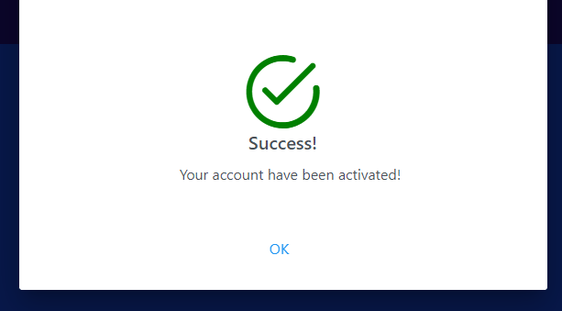
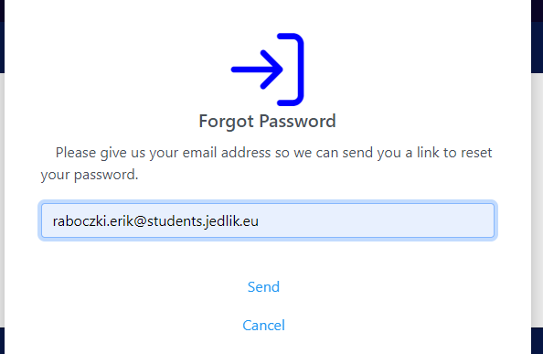
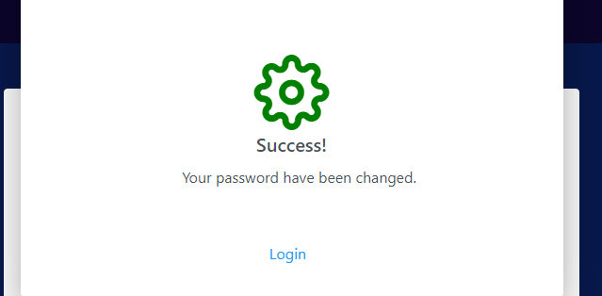
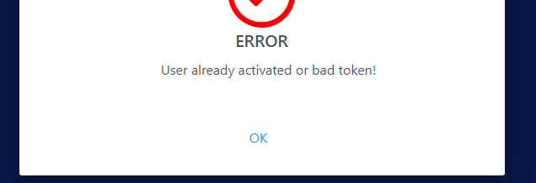
User management
Signup/Login/Forgot Password

Slide 6
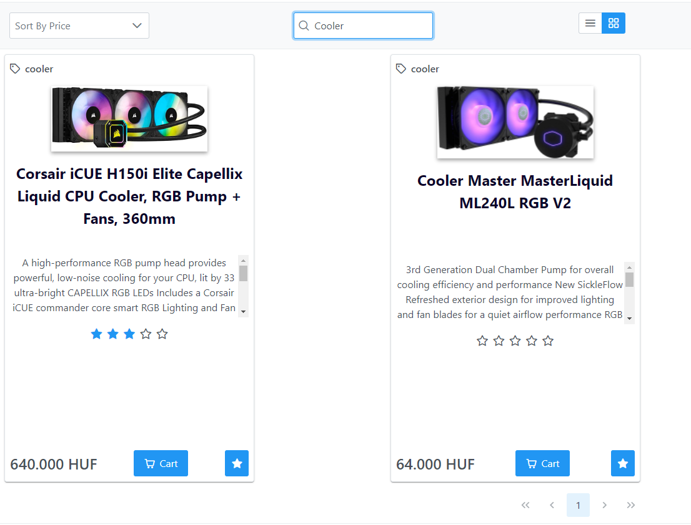
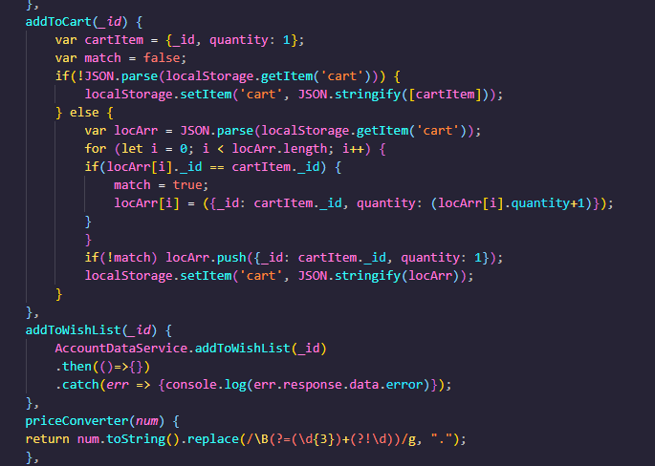
Products (registered user/guest)
Cart & Wishlist

Slide 7
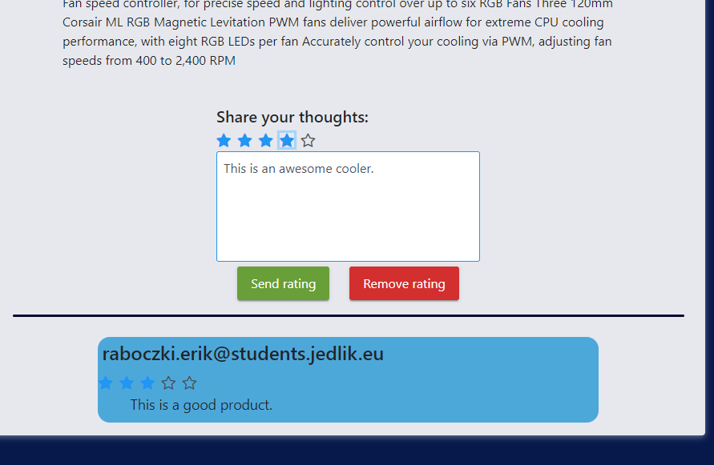
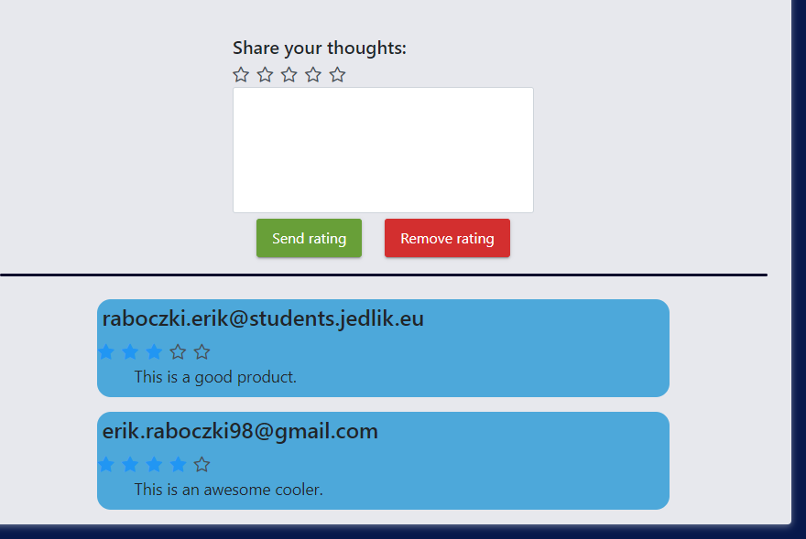
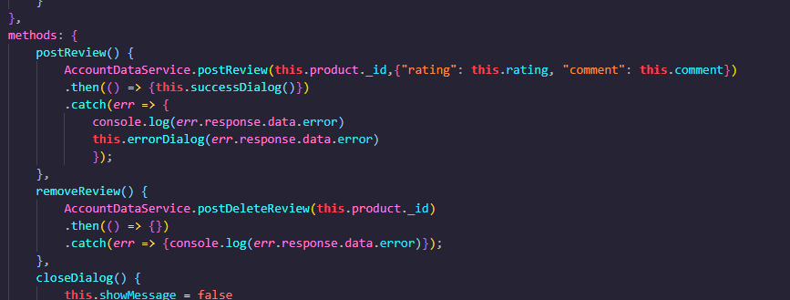
Products (registered user/guest)
Details & Feedback

Slide 8
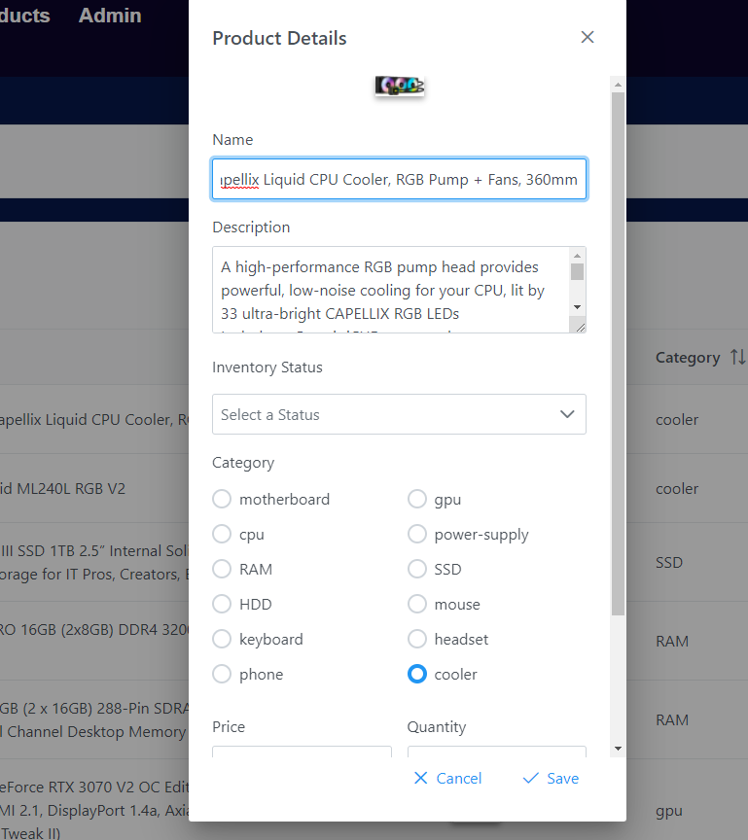
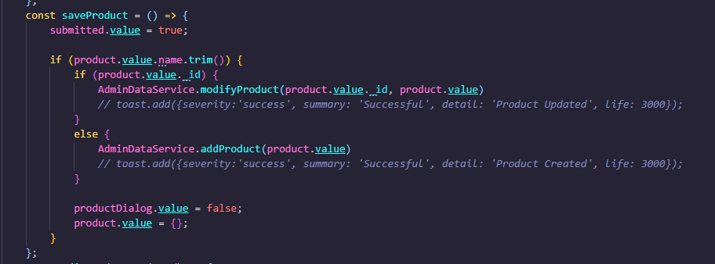
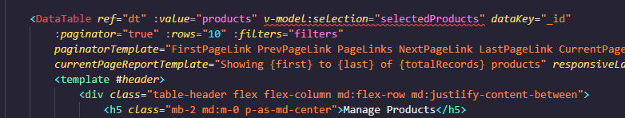
Admin page (CRUD)

Slide 9
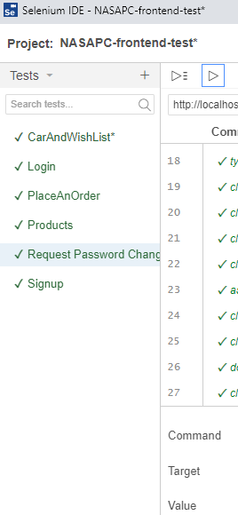
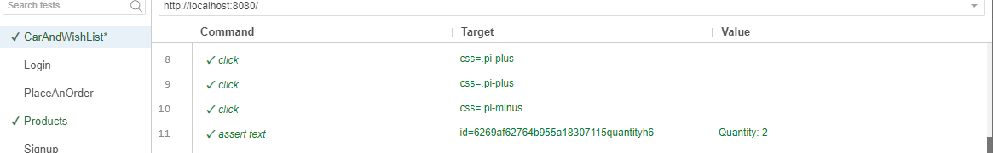
Selenium
Frontend Test

